Slide 1
Walking the City: Analysis of NYC’s Built Environment on Mental Health
Akshay Shetty - as16477@nyu.edu
Shantanu Anikhindi - saa9213@nyu.edu
Ajayrangan Kasturirangan - ak10196@nyu.edu
Maria Lucia Cornejo - mlc9958@nyu.edu
Vickram Peter - vp2379@nyu.edu
Sharvari Deshpande - sd5270@nyu.edu
Anshika Gupta - ag8800@nyu.edu

Slide 2
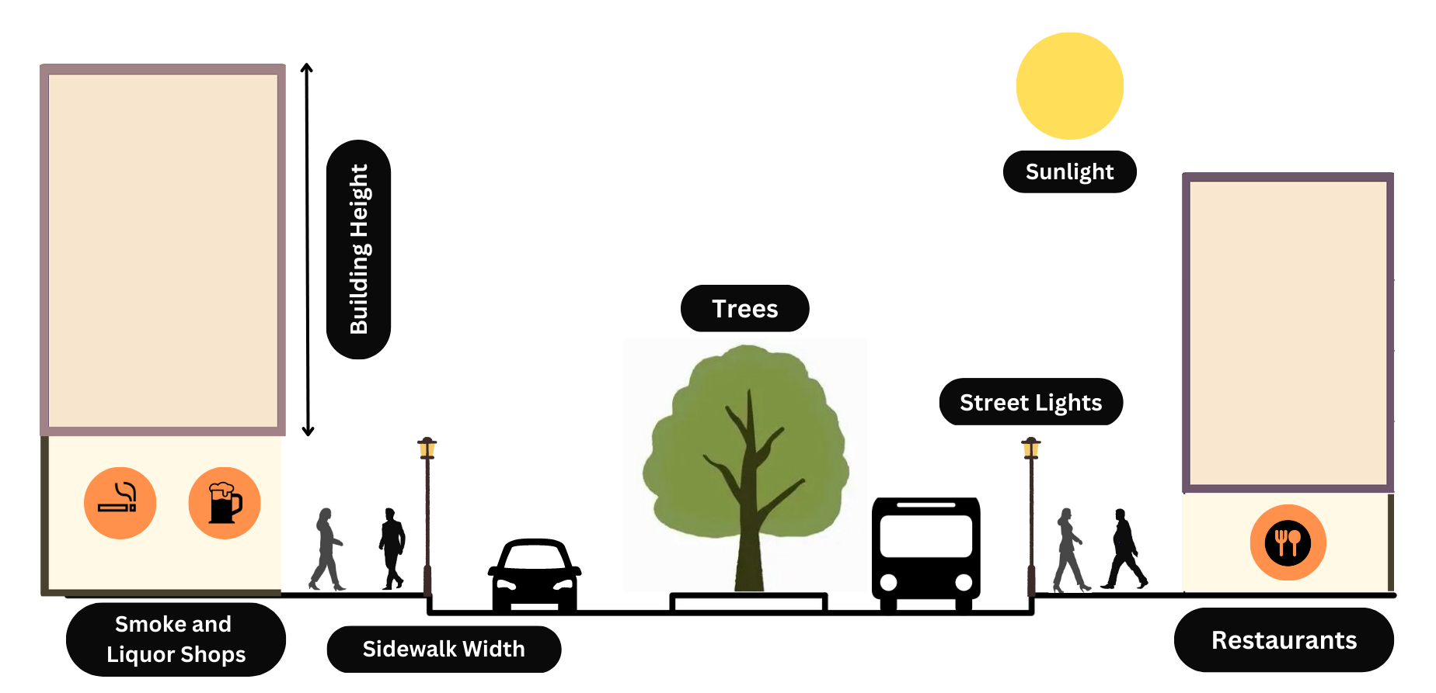
Walking the City: The Impact of NYC’s Built Environment on Mental Health

Slide 3
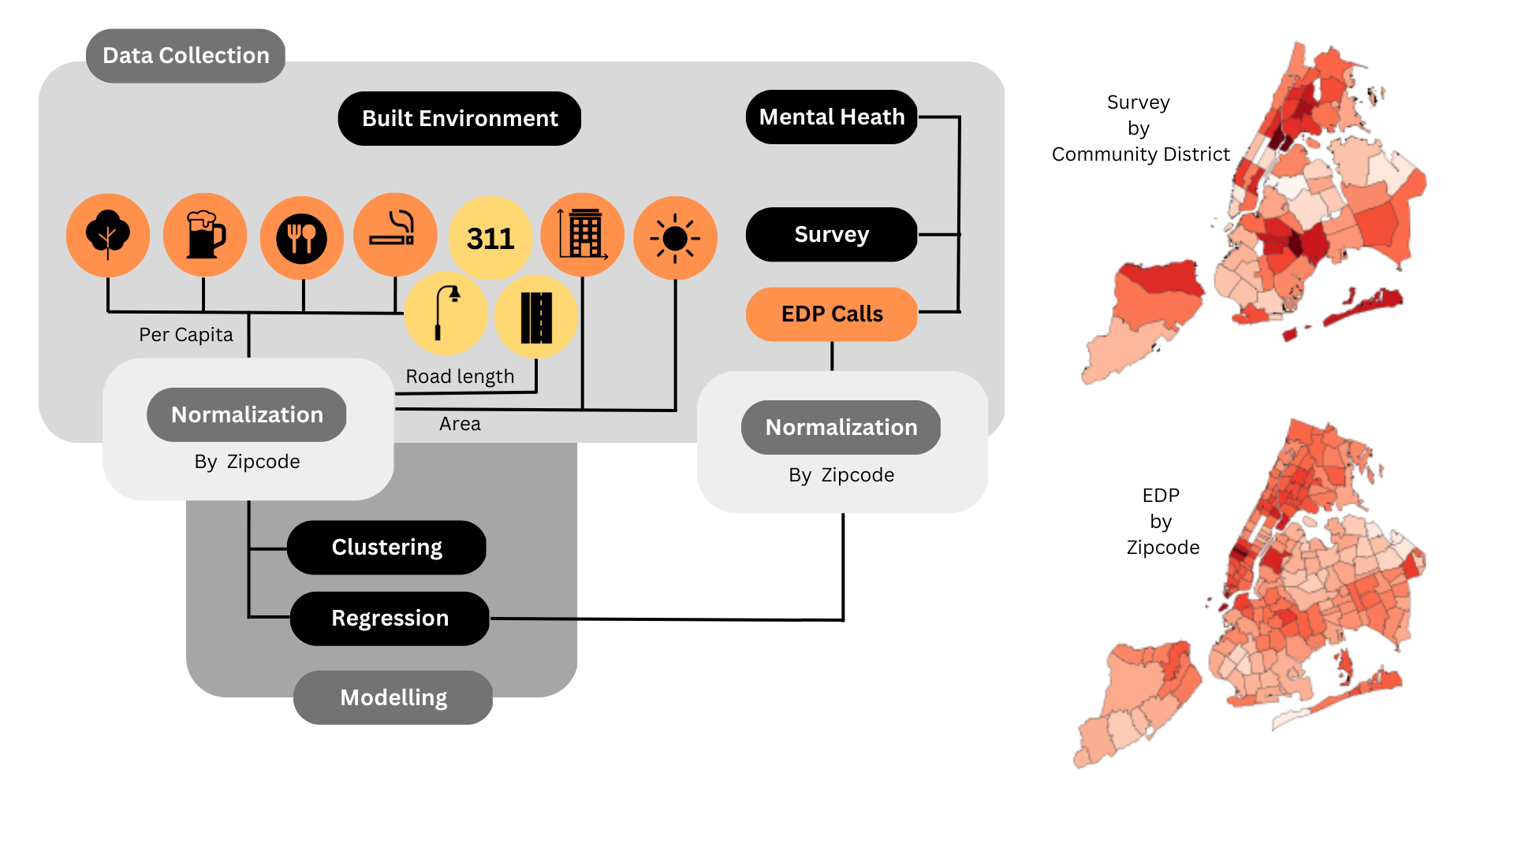
Data Engineering Pipeline
Notes:
For mental health we have inadequate data at the granular level. Therefore we decided to use emotionally distressed people (EDP) calls data from 911 as proxy. EDP to 911 refer to emergency calls where the caller is experiencing extreme emotional distress and requires immediate assistance. In order to ensure the accuracy of this proxy, we conducted a comparison between 911 data and Community Health Survey data from 2019, which revealed similarities in the geographic hotspots of individuals experiencing poorer mental health conditions as seen in the maps here. That is why for the rest of the analysis we’ll work with 911 data and use it to understand mental health patterns.
For understanding the condition of street lights and sidewalks, we used 311 data which is the dataset from non-emergency services in NYC. In the absence of street lights and sidewalk data we used 311 complaints data as proxy to understand sidewalk condition and to understand how well lit these footpaths are.
The limitation of 311 calls is that it primarily represents the concerns and needs of those who are more likely to have access to and use the service and is often biased against certain socio-economic groups.
We aggregated all our data at the zipcode level.
While normalizing the data, the variables with count which includes trees, liquor shops, restaurants, smoke shops were normalized per capita. Building heights and solar potential was normalized by zipcode area, and sidewalk widths was normalized by road length.
After normalizing we created two models. Firstly, we created a regression model with the built environment variables as independent variables and the mental health indicator as the target variable. Secondly, we did a clustering analysis to understand patterns in built environment across the city.

Slide 4
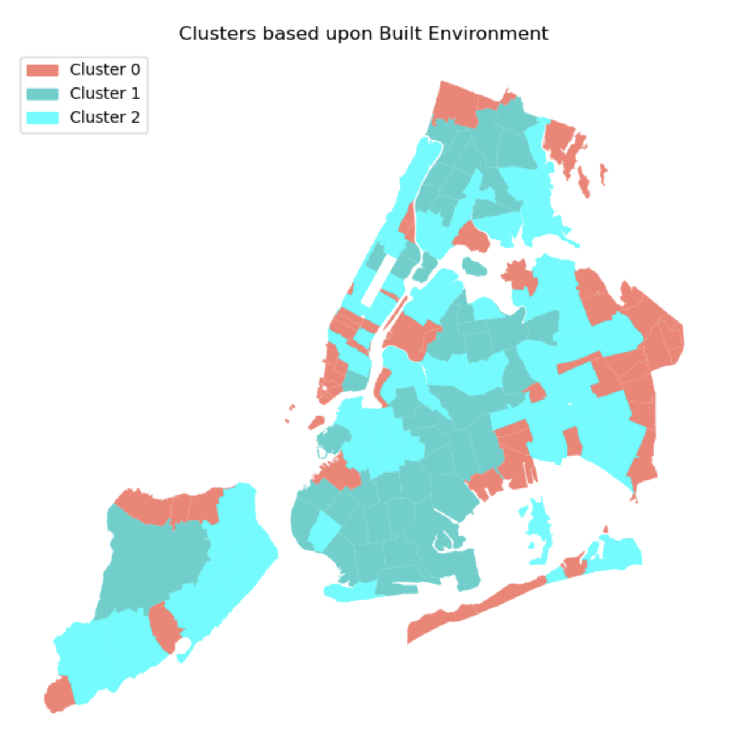
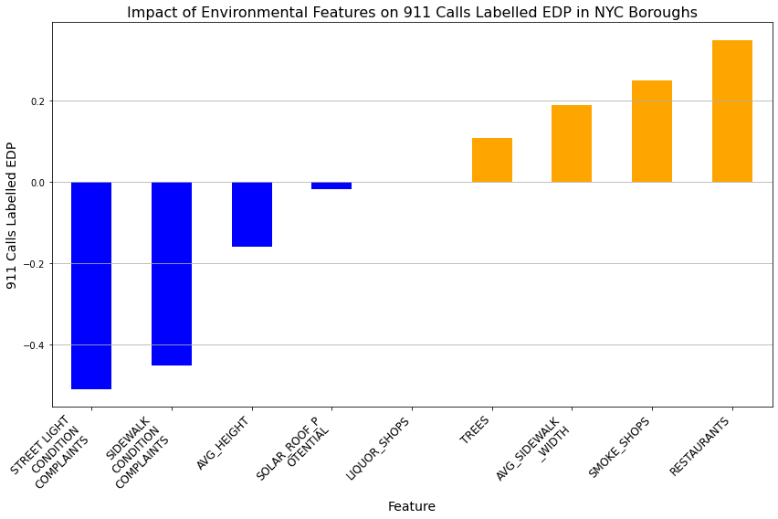
Regression Results and Clustering Conclusion

Slide 5
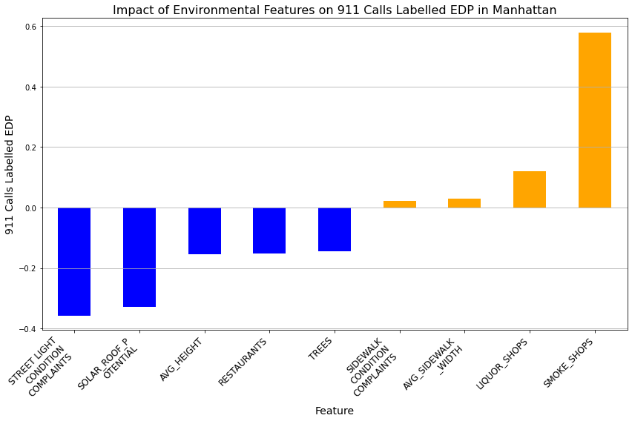
Regression Results and Clustering Conclusion

Slide 6
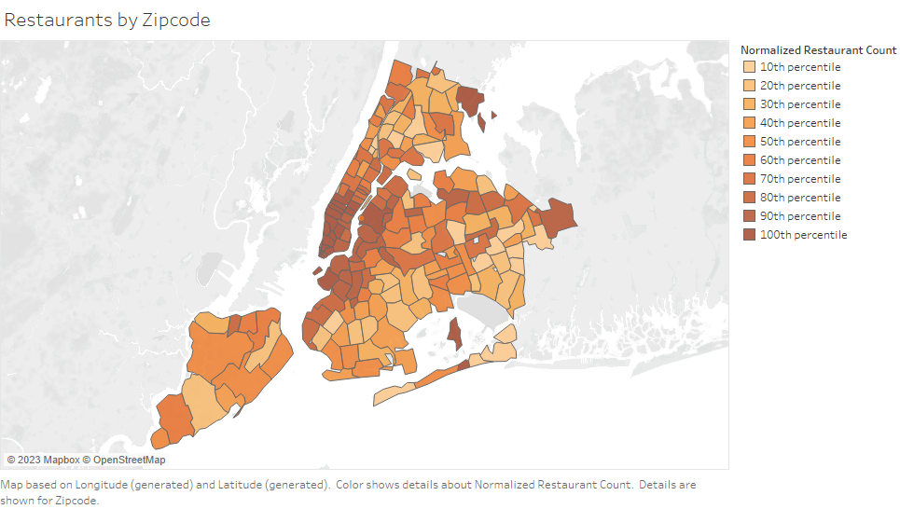
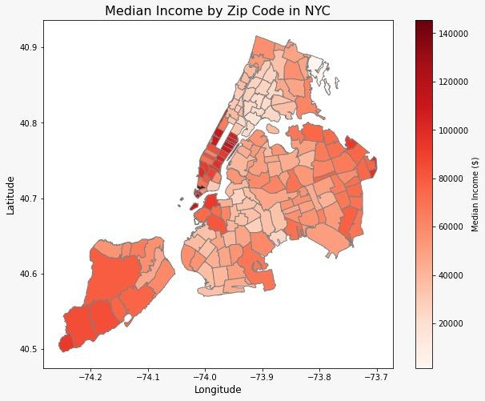
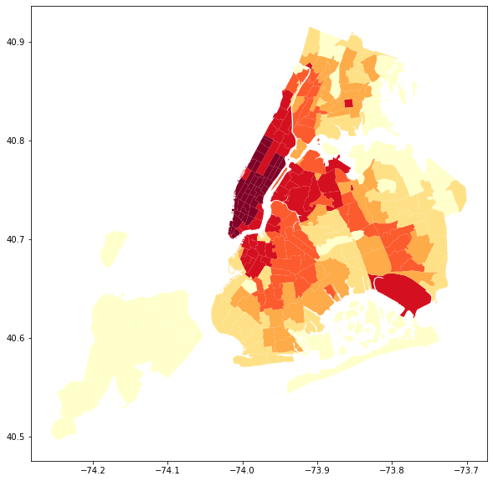
Future Work Recommendations
Regressors acting as a proxy for Activity.
Built-environment clustering vs income & mental health.
Time Series Analysis
Activity in NYC

